Slide 1
TAKENMIND GLOBAL DATA ANALYTICS INTERNSHIP
PROOF OF CONCEPT PROJECT
NAME : ADEYEMI OMOTOYOSI JAMMAL
COUNTRY : NIGERIA
EMAIL : oabass7@gmail.com
PROJECT TITLE ; EMPLOYEE ATTRITION CONTROL

Slide 2
Problem Statement
The data is for company X which is trying to control attrition. There are two sets of data: "Existing employees" and "Employees who have left".
Following attributes are available for every employee.
Satisfaction Level
Last evaluation
Number of projects
Average monthly hours
Time spent at the company
work accident
promotion in the last 5 years
Departments (column sales)
Salary Whether the employee has left

Slide 3
Objective
What type of employees are leaving? Determine which employees are prone to leave next.

Slide 4
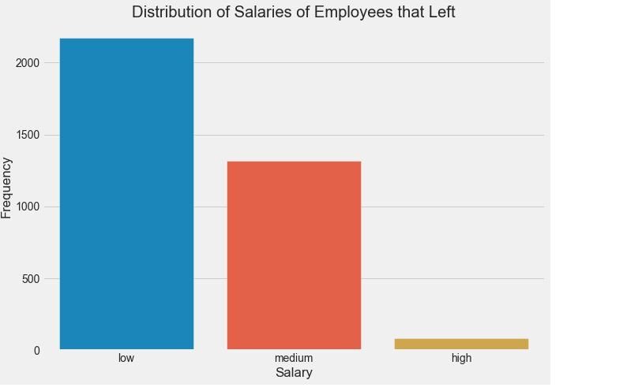
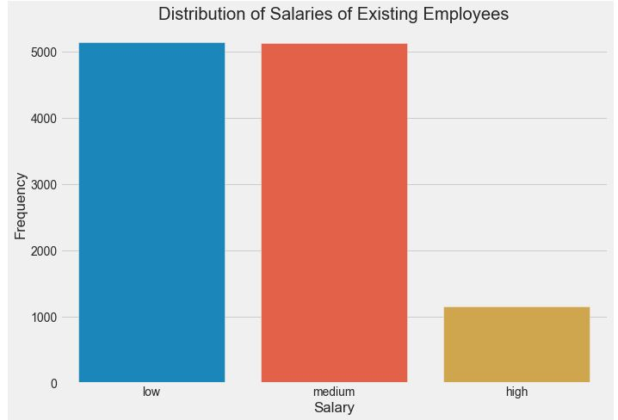
Visualization Analysis
Step 1 : UNIVARIANT ANALYSIS
This stage involve analyzing each features of the data
CHART 1

Slide 5
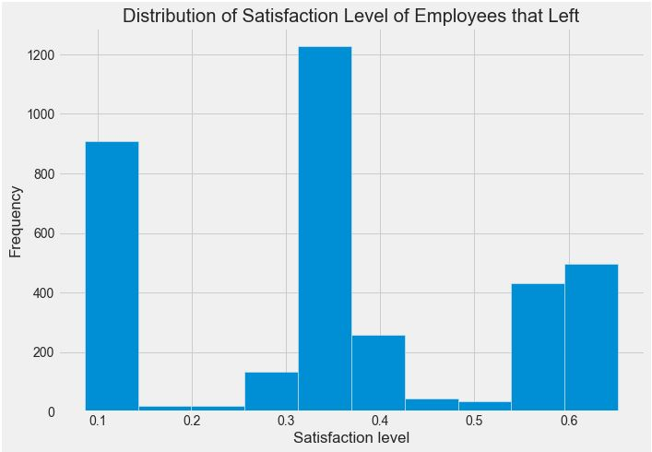
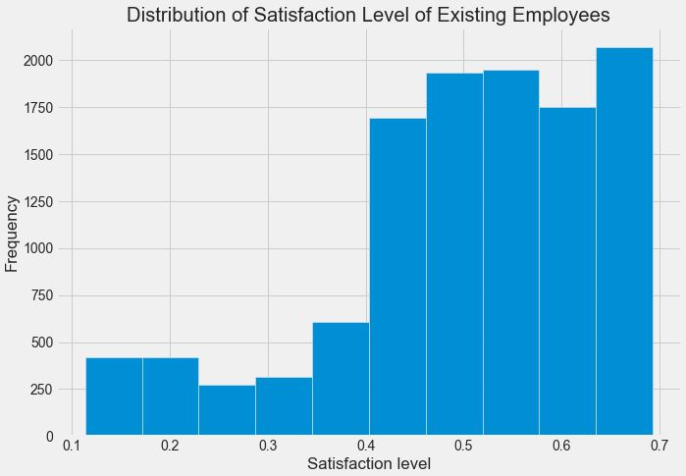
Univariant Analysis Cont’d
CHART 2

Slide 6
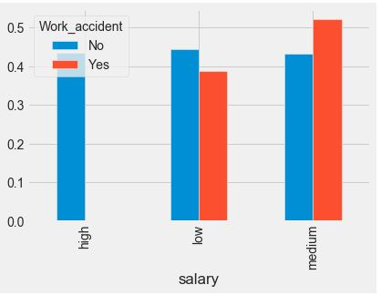
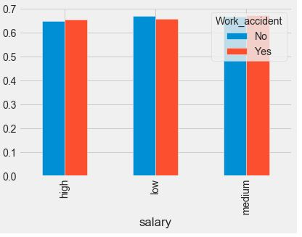
Step 2 : BIVARIANT ANALYSIS
This stage involve analyzing different features of the data the evaluate how correlated they are
CHART 3
Satisfaction Level of Employees that left
base on Work accident Salary Compensation"
Satisfaction Level of Existing Employees
base on Work accident Salary Compensation"

Slide 7
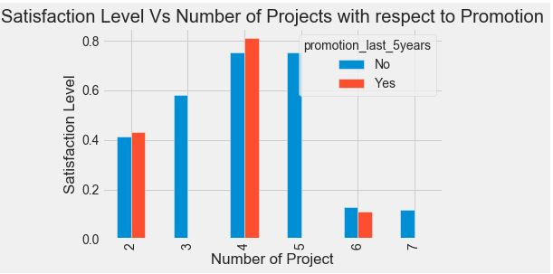
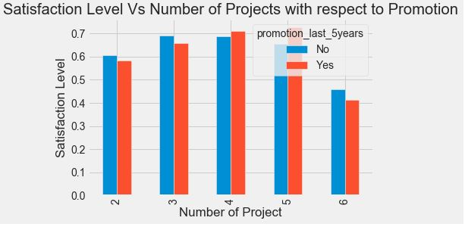
Multi-Variant Analysis
CHART 4
Satisfaction Level of Employees that left base on the
Number of Projects and Promotion
Satisfaction Level of Existing Employees base on the
Number of Projects and Promotion

Slide 8
STEP 3: Actionable Insights, Observations and Recommendations
The following insights and findings were discovered after exploring the data of the remaining workers and those leaving simultaneously;
1. From chat 2, the average amount of satisfaction level of employees leaving was about 40% while those left were about 70%. After further study, 65% of the workers who quit were found to have a satisfaction level of less than 45%. A deeper dive into examining this workers with a 45% satisfaction level that had left, it was further discovered that in the last 5 years 99.6% of them did not earn promotion.
The insights from employees who left offers a line of thought of checking 45% of current employees with the same degree of satisfaction and it was found that 13.8% of Existing employees are in this category of which 97.7% of them have not been promoted within the last 5 years, rendering them likely to leave.
Recommendation
This employees need to be identified and paid in one way or the other to control attrition in other to increase their level of satisfaction and loyalty to the company.

Slide 9
Cont’d
2. From chat 3, it was discovered that the pay structure of those that quit, who had work accident was within the Low and medium range, which was approximately 50% when examined from the satisfaction level point. ever, checking this information with those still in the company it was discovered that their salary was distributed into low, medium and high range which further increased satisfaction level.
This let us see that the company maintained a decent salary structure for those that had work accidents.
Recommendation
To control attrition, the salary structure must be retained or improved by the company as this will improve employees satisfaction since they are well paid and compensated.
This wage structure must be retained or enhanced by the organization, since this will increase employee satisfaction since they are well paid.

Slide 10
Cont’d
3. From chat 5, it was discovered that as the number of employees project that left increased more than 4, it resulted in a decrease in their level of satisfaction.
Recommendation
In order to prevent future attrition and continuously maintain a high degree of employee satisfaction level, the company should ensure that the number of projects assigned to an employee is not too daunting, thereby losing enthusiasm that could result in the need to leave.

Slide 11
Thank you TAKEN MIND for this Internship for helping me improve my
Data Analytics Skills

